Slide 1
This Week Work Progress
Lecturer：SUSTech Li Yuchen
2019.3.21

Slide 2
content
01
Kaggle
02
Mis-Classification analysis
03
Studying machine learning & Tensorflow

Slide 3
Kaggle
Part One
01

Slide 4
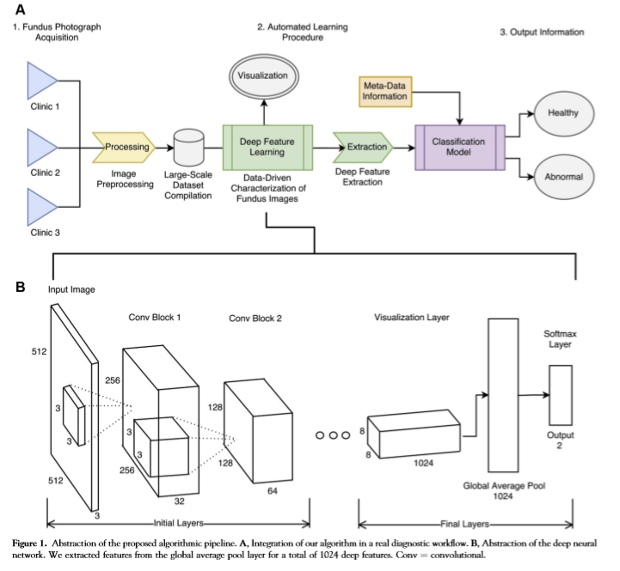
Automated Identification of Diabetic Retinopathy Using Deep Learning

Slide 5
Preprocessing
To resolve the problem of imbalanced category
Data set augmentation
Loss Function
Imbalanced-learn

Slide 6
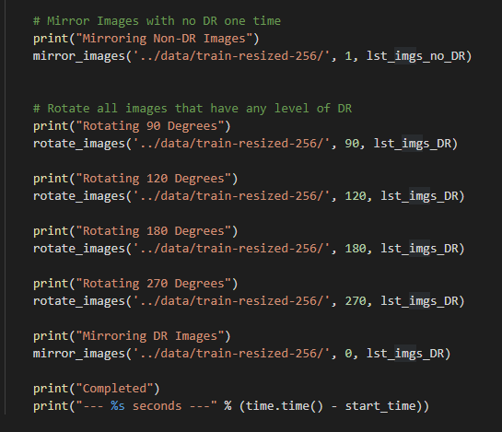
Data set augmentation to encode multiple invariances in deep feature learning methods
1. Image were downsized to a standard resolution of 512*512 pixels by cropping the inner retinal circle and padding it to a square
2. Rotationally invariant: image transformations.

Slide 7
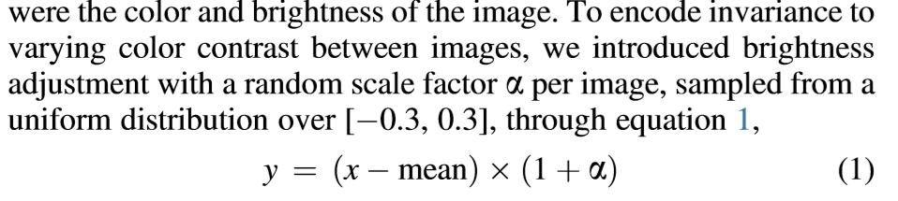
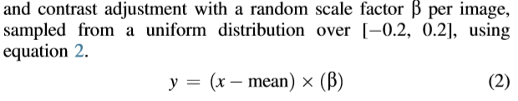
Brightness adjustment and contrast adjustment
Brightness adjustment
Contrast adjustment

Slide 8
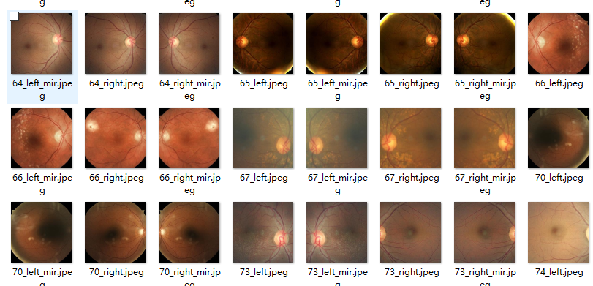
Crop and Rotation
0 | 1
25810 | 9316
50795 | 55410

Slide 9
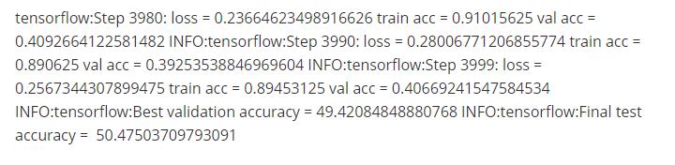
ResNet

Slide 10
Study
Part Three
03

Slide 11
Future plan
01
Analyze the reasons & find questions
02
Try the methods
02
Study

Slide 12
THANKS
And Your Slogan Here.

